Slide 1
Cracking the Credit: Card Approval with Machine Learning
By Group 10

Slide 2
Table of Content
01
04
Introduction
Model Training and Evaluation
02
05
Literature Review
Insights
03
06
Data Overview
Conclusion

Slide 3
01
Introduction

Slide 4
Project Motivation

Slide 5
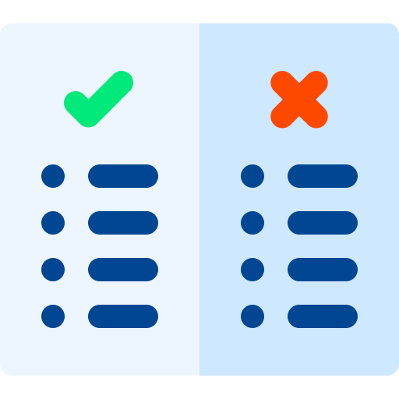
Project Motivation
Identify “good” and “bad” credit card applicants using Machine Learning models

Slide 6

Project Motivation
Automate card approving process
Identify “good” and “bad” credit card applicants using Machine Learning models

Slide 7

Project Motivation
Automate card approving process
Handle high volume of applicants
Identify “good” and “bad” credit card applicants using Machine Learning models

Slide 8

Project Motivation
Automate card approving process
Handle high volume of applicants
Gain insights into factors affecting credit worthiness
Identify “good” and “bad” credit card applicants using Machine Learning models

Slide 9
Problem Statement

Slide 10

Problem Statement
Binary classification problem

Slide 11
Problem Statement
Binary classification problem
:
0
Good Credit Card Applicant
- No red flags in Application
- Application is accepted
1
Bad Credit Card Applicant
- Red flags in Application
- Application is rejected

Slide 12

Problem Statement
: Binary classification problem
Construct labels using credit_record

Slide 13

Problem Statement
: Binary classification problem
Construct labels using credit_record
Predict labels using application_record

Slide 14
02
Literature Review

Slide 15

Literature Review
Real-world Credit Approval Rate

Slide 16

Literature Review
Real-world Credit Approval Rate
Existing Projects on Kaggle

Slide 17

Real-world Credit Approval Rate
Real-world data
No labels of ‘good’ or ‘bad’ applicants

Slide 18
Real-world Credit Approval Rate
Real-world data
Define ‘good’ or ‘bad’ applicants

Slide 19
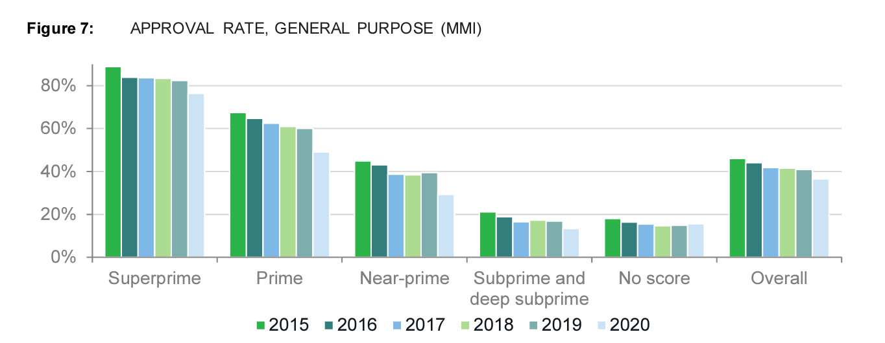
Real-world Credit Approval Rate
According to US Bureau of Consumer Financial Protection, consumers with credit scores "Superprime" have an approval rate of ~80%.
Takeaway:
It is reasonable to label ~20% of applications as “bad”.
Consumer Financial Protection Bureau. (2021, September). The Consumer Credit Card Market. https://files.consumerfinance.gov/f/documents/cfpb_consumer-credit-card-market-report_2021.pdf, Page 70.

Slide 20
Existing Projects on Kaggle

Slide 21

Existing Projects on Kaggle
Most existing projects on Kaggle only explore baseline and linear models.

Slide 22
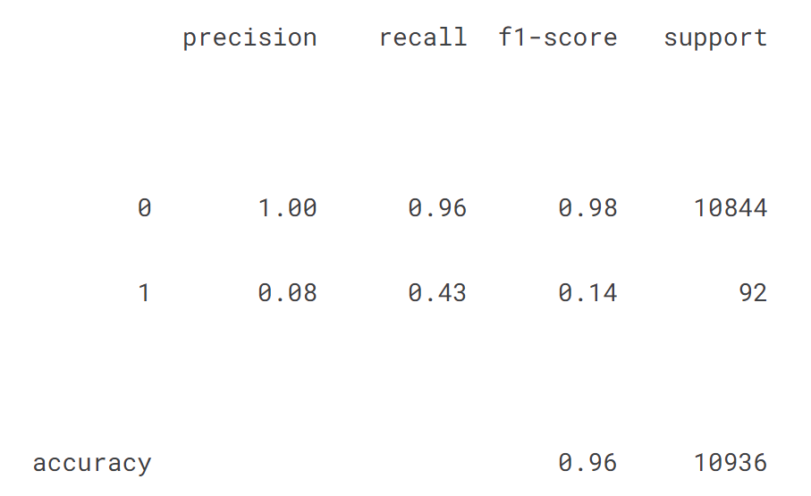
Existing Projects on Kaggle
Most existing projects on Kaggle only explore linear models.
Takeaway:
We should use oversampling on bad customers to overcome the imbalance problem.
Explore beyond linear models.
Linear models perform poorly on this project due to highly imbalanced data (Too few bad customers).
Emirhansabah. (2023, August 2). Credit card approval. Kaggle. https://www.kaggle.com/code/emirhansabah/credit-card-approval

Slide 23
Original Proposal

Slide 24
Original Proposal
Incorporate Real-world financial knowledge in constructing labels

Slide 25

Original Proposal
Incorporate Real-world financial knowledge in constructing labels
Diversify model exploration into non-linear models

Slide 26
03
Data Overview
Notes:
In introduction

Slide 27


Data Overview
Label Definition
Data Processing &
Feature Engineering
application_record
credit_record

Slide 28
credit_record
Label Definition
in

Slide 29
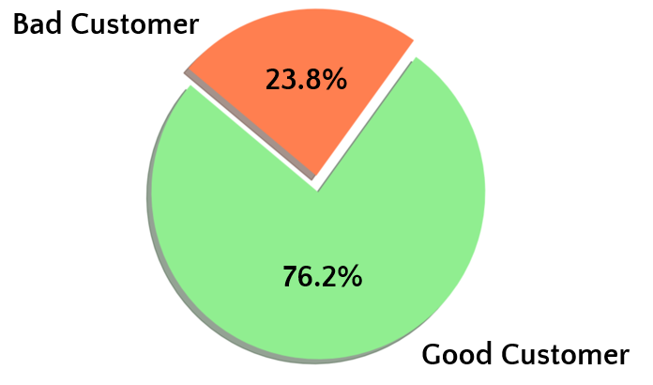
credit_record
Label Definition
in
Following the 20% rejection ratio derived from real-world financial data:
A customer is bad if he has >= 12 “bad months” in credit_record dataset.
A “bad month” is when one has loan overdue by any number of days (aka, “STATUS” column is one of 0,1,2,3,4,5).

Slide 30
application_record
Data Processing
in

Slide 31
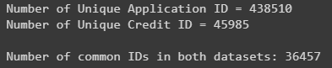
Data Processing
application_record
in
There is a large difference in number of unique IDs in credit_record and application_record.

Slide 32
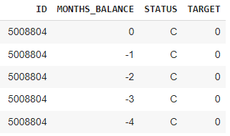
Data Processing
application_record
in
Supervised Learning requires labels.
credit_record

Slide 33
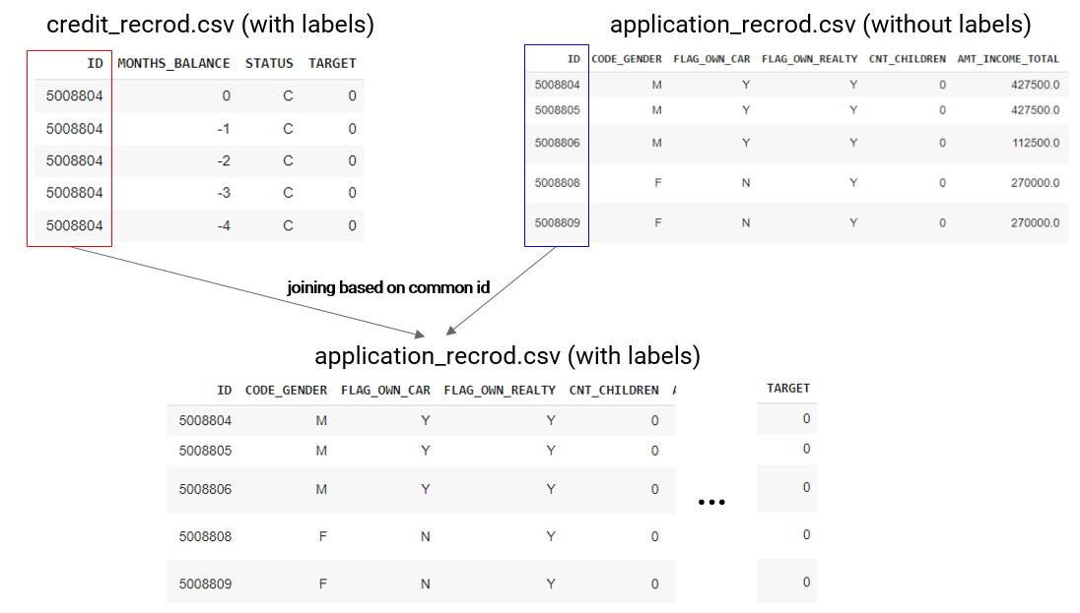
Data Processing
application_record
in
Two datasets will be joined based on shared columns (ID).

Slide 34
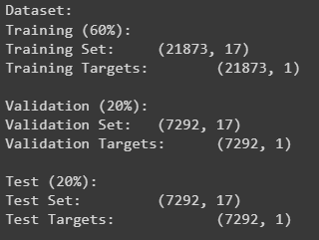
Data Processing
application_record
in
The data is split into 60-20-20 ratio for training, validation and test.

Slide 35
application_record
Feature Engineering
in

Slide 36

Feature Engineering
application_record
in
Feature Pruning

Slide 37

Feature Engineering
application_record
in
Feature Pruning
Encoding and Scaling

Slide 38

Feature Engineering
application_record
in
Feature Pruning
Encoding and Scaling
Oversampling

Slide 39
Feature Pruning

Slide 40
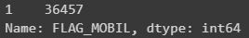
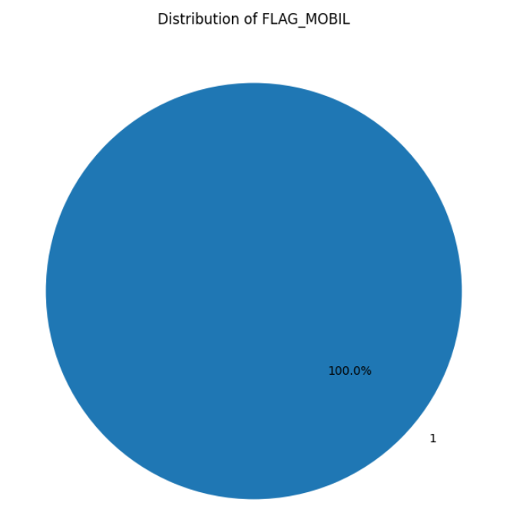
Feature Pruning
Drop FLAG_MOBIL
since all values are “1”

Slide 41
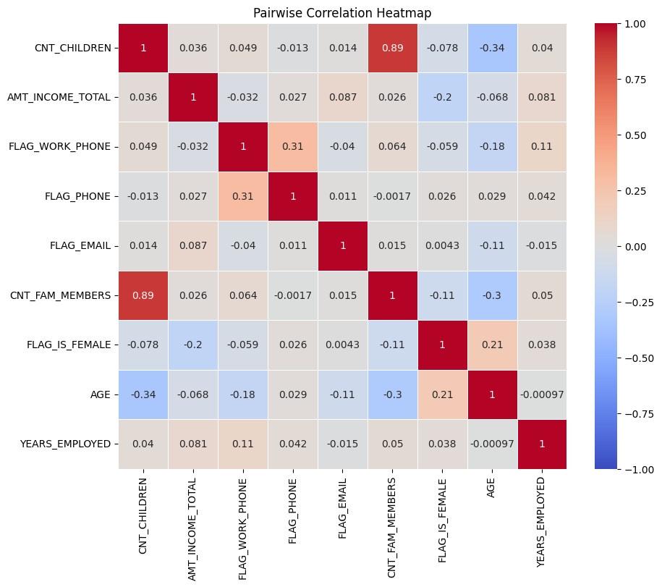
Feature Pruning
Drop CNT_CHILDREN due to high correlation with CNT_FAM_MEMBERS

Slide 42
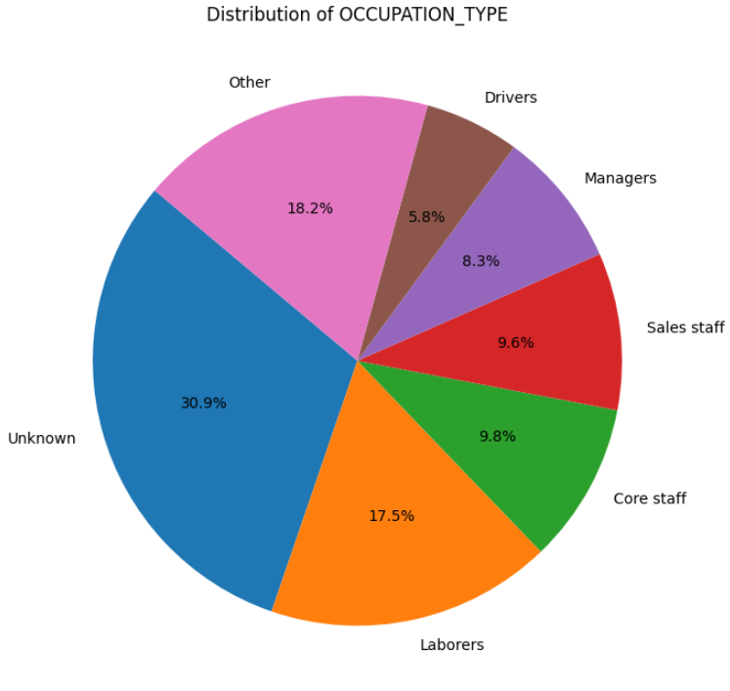
Feature Pruning
'Waiters/barmen staff’
'Cleaning staff’
'Cooking staff’
'High skill tech staff’
'Private service staff’
'Accountants’
'Security staff’
'Secretaries’
'Medicine staff’
'Low-skill Laborers’
'HR staff’
'Realty agents’
'IT staff'
Drop OCCUPATION_TYPE due to high cardinality and large percentage of missing values ( 31% “Unknown”)

Slide 43
Encoding and Scaling

Slide 44
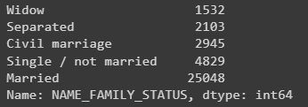
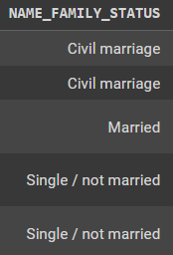
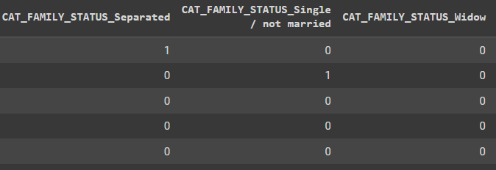
Encoding and Scaling
Used one-hot encoding for all remaining categorical features

Slide 45
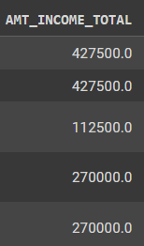
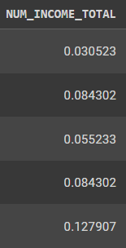
Encoding and Scaling
Normalized all numerical features

Slide 46
Oversampling

Slide 47
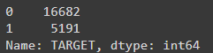
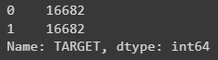
Oversampling
Used SMOTENC to oversample a mix of categorical and numerical features

Slide 48
04
Model Training &
Evaluation
Notes:
In introduction

Slide 49
List of Models Tested
A | Logistic Regression
 | Linear classification based on probabilities.
B | Support Vector Machine (SVM)
 | Hyperplane-based binary classifier.
C | Neural Network
 | Deep learning model for complex pattern recognition.
D | k-Nearest-Neighbours (kNN)
 | Instance-based proximity classifier.
E | Decision Tree and Random Forest
 | Tree-based ensemble learning for classification.

Slide 50
Model Evaluation Criteria
Recall
01
Evaluates the model's ability to identify all relevant instances within a class.

Slide 51
Model Evaluation Criteria
Recall
01
Evaluates the model's ability to identify all relevant instances within a class.
F1 Score
02
Balances precision and recall, indicating model accuracy across classes.

Slide 52
Model Evaluation Criteria
Recall
01
Evaluates the model's ability to identify all relevant instances within a class.
F1 Score
02
Balances precision and recall, indicating model accuracy across classes.
ROC-AUC Score
03
Measure of model's ability to distinguish classes.

Slide 53
Model Evaluation Criteria
Recall
01
Evaluates the model's ability to identify all relevant instances within a class.
F1 Score
02
Balances precision and recall, indicating model accuracy across classes.
ROC-AUC Score
03
Measure of model's ability to distinguish classes.
Accuracy
04
Overall correct predictions ratio disregarding class imbalance.

Slide 54
A: Logistic Regression

Slide 55
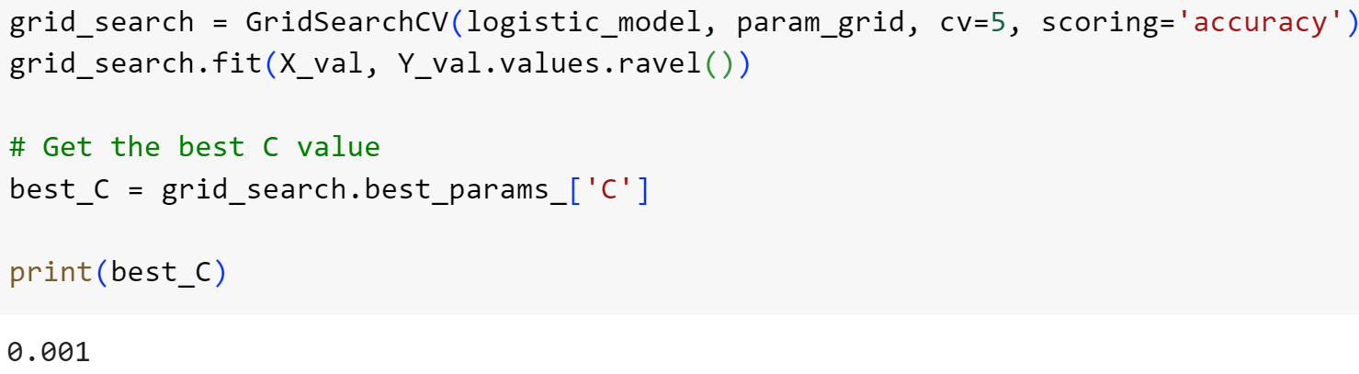
A: Logistic Regression
: Tuning
Grid Search
Optimal regularization strength C=0.001
1000 iterations for convergence

Slide 56
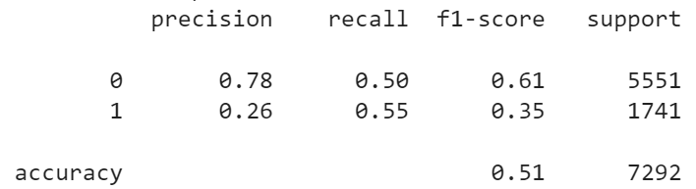
A: Logistic Regression
: Performance
Recall = 0.55
F1-score = 0.35
Accuracy = 0.51
ROC-AUC score = 0.52

Slide 57
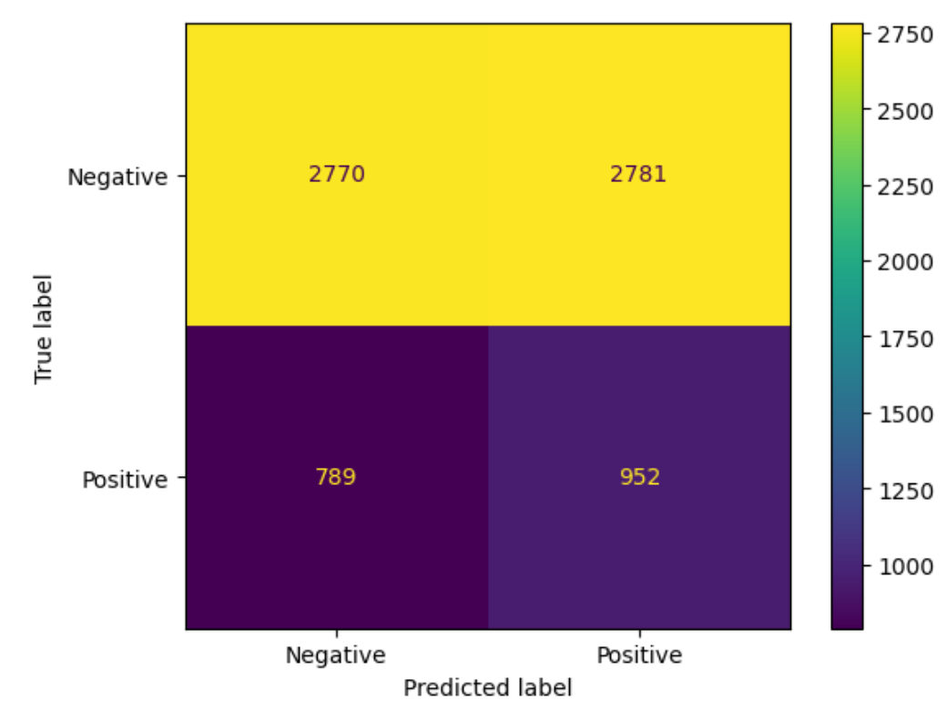
A: Logistic Regression
: Evaluation
Reasons for poor performance:
Oversampling may have led to increase in False Positives
Data is not linearly separable

Slide 58
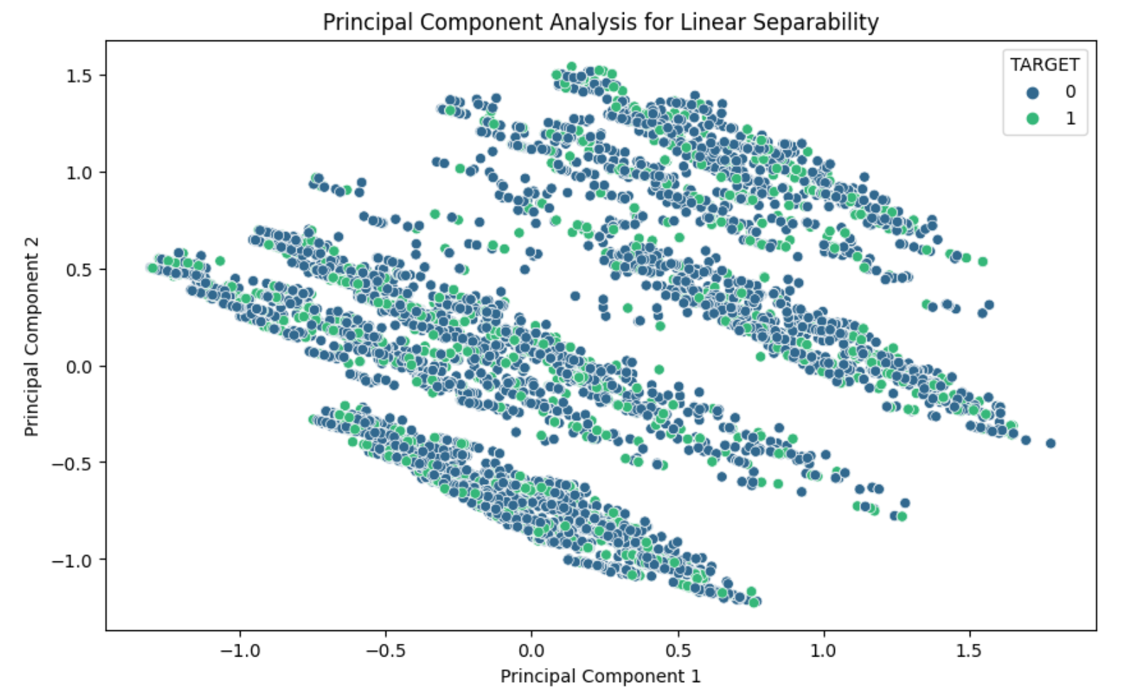
A: Logistic Regression
: Evaluation
Reasons for poor performance:
Oversampling may have led to increase in False Positives
Data is not linearly separable

Slide 59
A: Logistic Regression
: Improvements
Adding on interaction terms and use with logistic stepwise regression to select the best performing features.

Slide 60
B: Support Vector Machine (SVM)

Slide 61
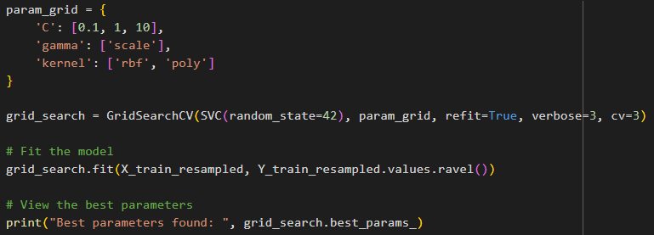
B: Support Vector Machine (SVM)
: Tuning
Grid Search
Best C = 10
Best gamma = “scale”
Best kernel = rbf

Slide 62
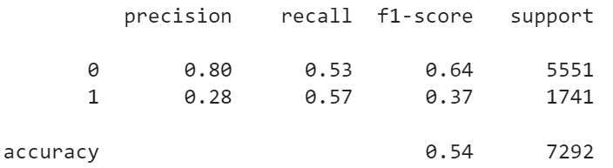
B: Support Vector Machine (SVM)
: Performance
Recall = 0.57
F1-score = 0.37
Accuracy = 0.54
AUC-ROC score = 0.55

Slide 63


B: Support Vector Machine (SVM)
: Evaluation
SVM Performance
Logistic Regression Performance
Recall = 0.57
F1-score = 0.37
Accuracy = 0.54
AUC-ROC score = 0.55
Recall = 0.55
F1-score = 0.35
Accuracy = 0.51
ROC-AUC score = 0.52
Vs

Slide 64
B: Support Vector Machine (SVM)
: Improvements
Use grid search to try out more parameters under faster computation environment

Slide 65
C: Neural Network

Slide 66

: Setup
C: Neural Network
Input layer with 128 neurons, RELU
Hidden layer with 64 neurons, RELU
Hidden layer with 32 neurons, RELU
1 output neuron, Sigmoid

Slide 67
: Tuning
C: Neural Network
Adjust number of training epochs

Slide 68
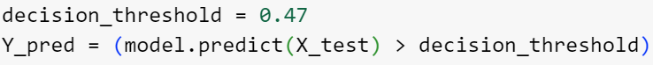
: Tuning
C: Neural Network
Adjust number of training epochs
Adjust decision threshold

Slide 69
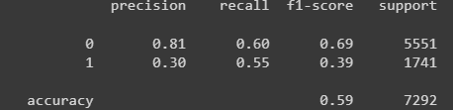
: Performance
C: Neural Network
Recall = 0.55
F1-score = 0.39
Accuracy = 0.60
AUC-ROC = 0.58

Slide 70

: Evaluation
C: Neural Network
Neural Network Performance
SVM Performance
Recall = 0.55
F1-score = 0.39
Accuracy = 0.60
AUC-ROC = 0.58
Recall = 0.57
F1-score = 0.37
Accuracy = 0.54
AUC-ROC score = 0.55
Vs

Slide 71
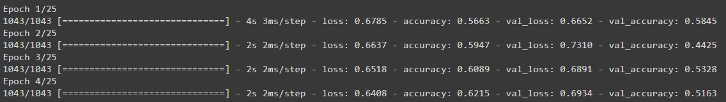
: Improvements
C: Neural Network
Try out different shapes of NN with faster computers
Try different number of layers and neurons
NN is resource-intensive, especially with high number of epochs

Slide 72
D: k-Nearest-Neighbours (kNN)

Slide 73
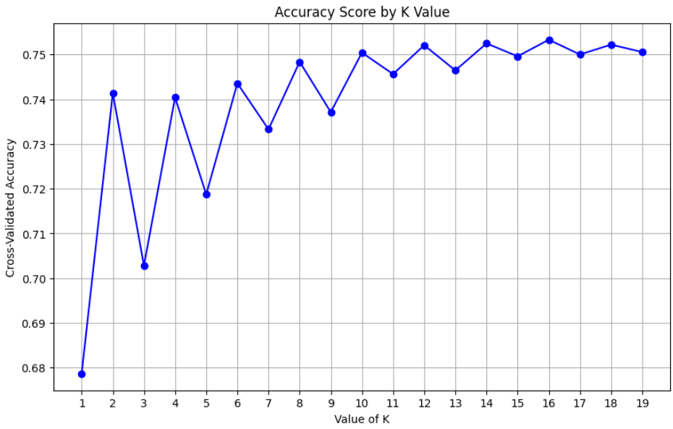
D: k-Nearest-Neighbours (kNN)
: Tuning
Performed Cross-Validation to get
k value = 12

Slide 74
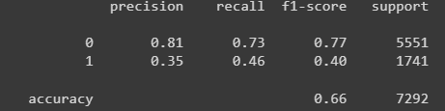
D: k-Nearest-Neighbours (kNN)
: Performance
Recall = 0.46
F1-score = 0.40
Accuracy = 0.66
AUC-ROC = 0.59

Slide 75
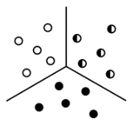
D: k-Nearest-Neighbours (kNN)
: Evaluation
KNN Performance
Neural Network Performance
Recall = 0.46
F1-score = 0.40
Accuracy = 0.66
AUC-ROC = 0.59
Recall = 0.55
F1-score = 0.39
Accuracy = 0.60
AUC-ROC = 0.58
Vs

Slide 76

D: k-Nearest-Neighbours (kNN)
: Improvements
Perform more in-depth feature engineering by using PCA to reduce dimensions.

Slide 77
and Random Forest
E: Decision Tree

Slide 78
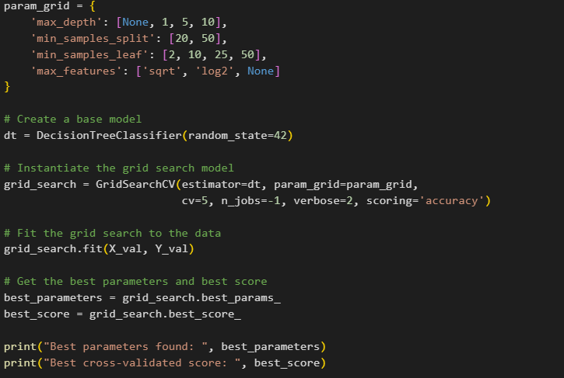
: Tuning
E: Decision Tree
Grid Search
Best max_depth = None
Best min_samples_split = 20
Best min_samples_leaf = 50
Best max_features = log2

Slide 79
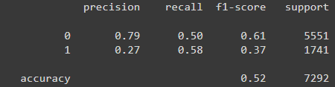
: Performance
E: Decision Tree
Recall = 0.58
F1-score = 0.37
Accuracy = 0.52
AUC-ROC = 0.54

Slide 80
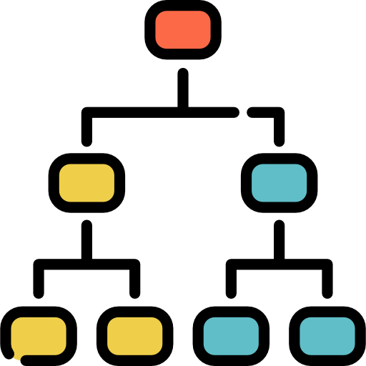
: Evaluation
E: Decision Tree
Decision Tree Performance
KNN Performance
Recall = 0.58
F1-score = 0.37
Accuracy = 0.52
AUC-ROC = 0.54
Recall = 0.46
F1-score = 0.40
Accuracy = 0.66
AUC-ROC = 0.59
Vs

Slide 81

: Improvements
E: Decision Tree
Implement Random Forest which can leverage ensemble learning to mitigate overfitting and improve predictive accuracy.
Random Forest

Slide 82
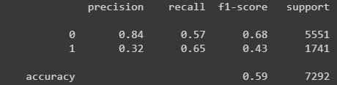
Random Forest
: Performance
E:
Recall = 0.65
F1-score = 0.43
Accuracy = 0.59
AUC-ROC = 0.61

Slide 83
Random Forest
: Evaluation
E:
Random Forest Performance
Decision Tree Performance
Recall = 0.65
F1-score = 0.43
Accuracy = 0.59
AUC-ROC = 0.61
Recall = 0.58
F1-score = 0.37
Accuracy = 0.52
AUC-ROC = 0.54
Vs

Slide 84
: Evaluation
E: Random Forest
Random Forest Performance
KNN Performance
Recall = 0.65
F1-score = 0.43
Accuracy = 0.59
AUC-ROC = 0.61
Recall = 0.46
F1-score = 0.40
Accuracy = 0.66
AUC-ROC = 0.59
Vs

Slide 85
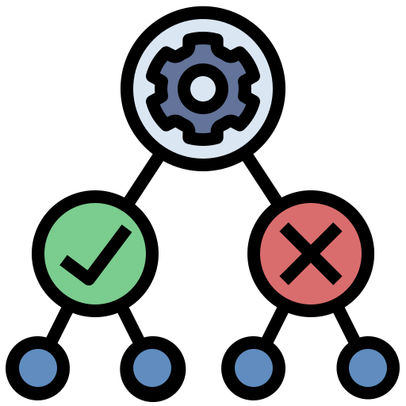
Random Forest
: Improvements
E:
Improved feature selection through techniques like:
recursive feature elimination
incorporating domain knowledge to select relevant features.

Slide 86
05
Insights
Notes:
In introduction

Slide 87
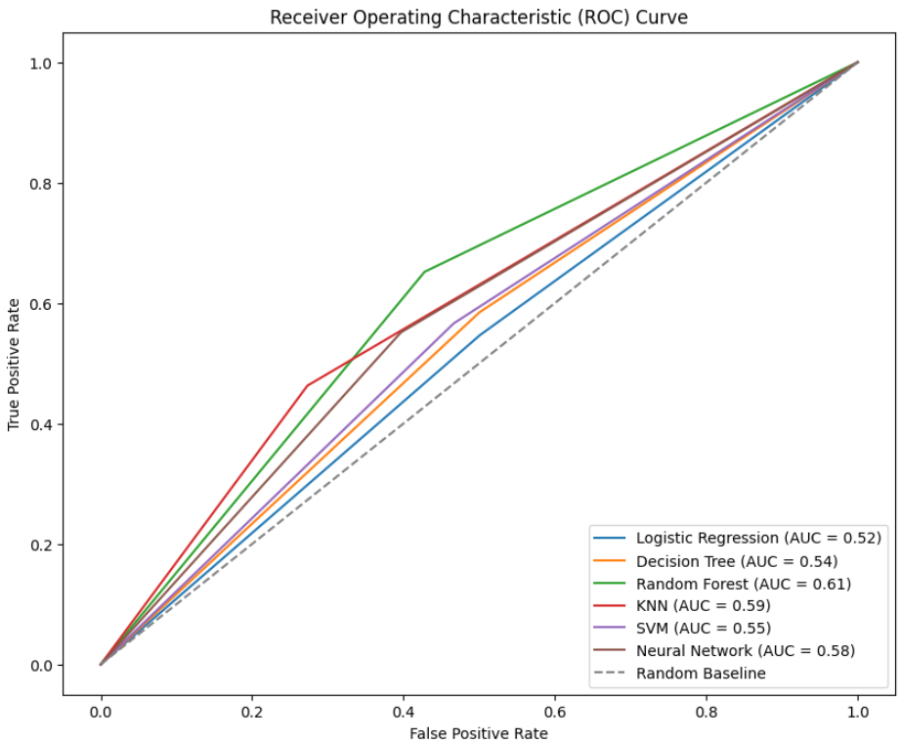
Insights
Best model is Random Forest.
Worst model is Logistic Regression.
Random Forest
Logistic Regression

Slide 88

Insights
Local Interpretable Model-agnostic Explanations (LIME)
LIME
Vs
Random Forest
Logistic Regression

Slide 89
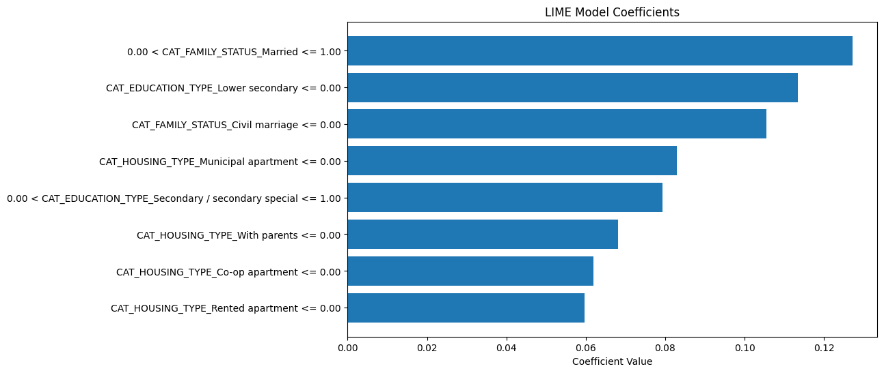
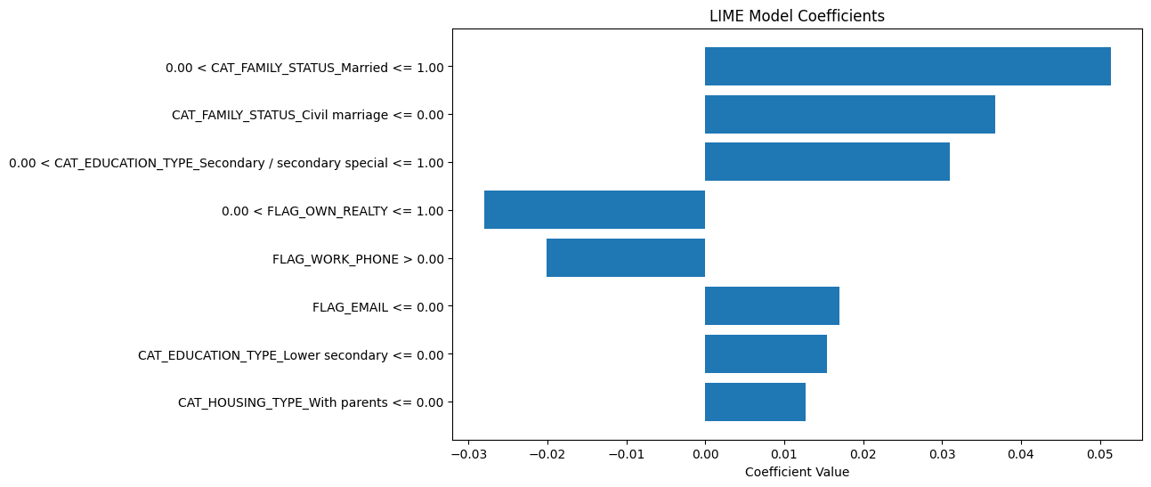
: LIME Evaluations
LIME
Insights
1. TP for both models
True Positive
RF
True Positive
LR

Slide 90
: LIME Evaluations
LIME
Insights
1. TP for both models
The following factors contribute significantly to bad customer prediction in both models:
Married (including civil marriage)
Having low education (lower secondary or secondary)
Living with parents
RF
LR

Slide 91
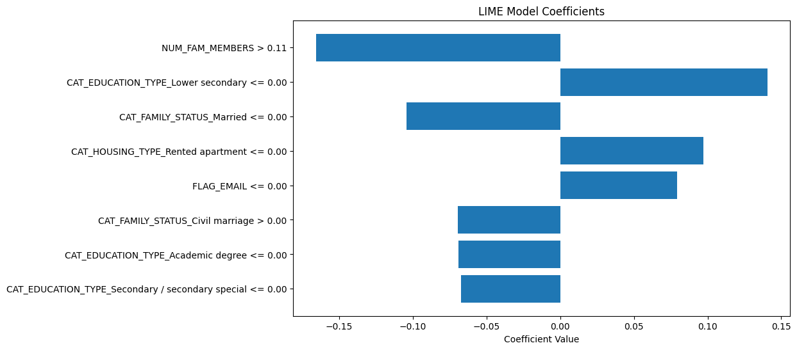
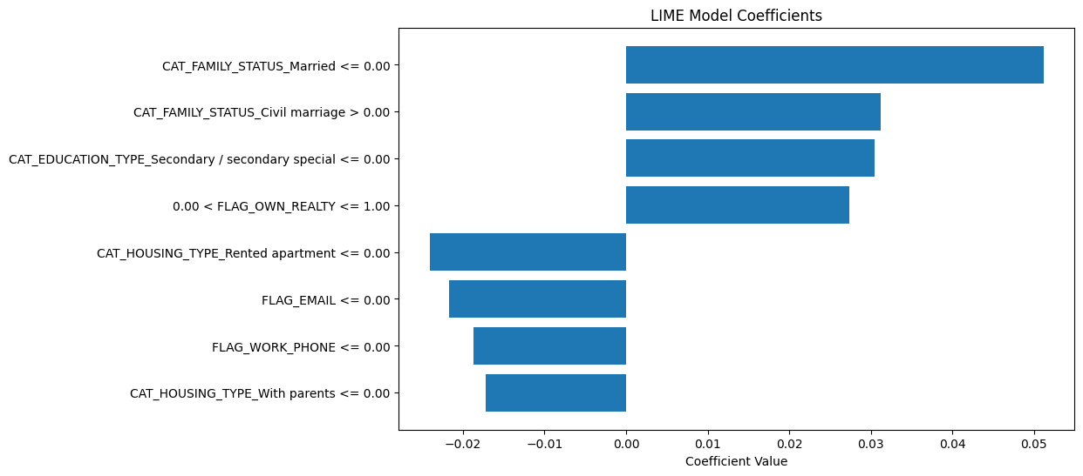
: LIME Evaluations
LIME
Insights
2. TP for RF, FN for LR
True Positive
RF
False Negative
LR

Slide 92
: LIME Evaluations
LIME
Insights
2. TP for RF, FN for LR
Best model gives high significance to number of family members, while worst model does not consider it.
RF
Best model gives greatest consideration to education level, while worst model to Married status
LR

Slide 93
: LIME Evaluations
LIME
Insights
2. TP for RF, FN for LR
Best model gives high significance to number of family members, while worst model does not consider it.
RF
Best model gives greatest consideration to education level, while worst model to Married status
LR

Slide 94
06
Conclusion
Notes:
In introduction

Slide 95

Conclusion
Random Forest

Slide 96
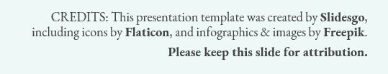
THANK YOU

